Slide 1


Income & Financial Factors Influencing Health Outcomes
A Data Mining Study Using BRFSS 2024
Team members:
Dhanush Mathivanan
Vaishali Jayaram
Simbarashe Mpofu

Slide 2
To understand how income and related financial/social factors affect overall health outcomes.
Goal:
Smart Question:
Does financial stability influence whether a person reports Good Health or Poor Health?
Next Page

Slide 3
Project Workflow Process Diagram
RAW DATA IMPORT FROM US CDC WEBSITE
TRANSFORM DATA INTO READABLE CSV FORMAT
CLEAN & FILTER DATA FOR EDA
HANDLING THE CLASS IMBALANCE
SUMMARIZE THE RESULTS AND CONCLUDE
BUILD THE HEALTH PREDICTOR APP
EXPORT BEST MODEL OUTPUT
MODEL TRAINNING

Slide 4




Why we chose General Health Status?
Poor Health
Comprehensive measure combining physical, mental, and functional health
Used widely in public health research
Strongly associated with economic and social conditions
Converted into:
Good Health (0): Excellent / Very Good / Good
Poor Health (1): Fair / Poor
Good Health
This makes health interpretable & model-friendly.

Slide 5



Dataset Overview & Data Cleaning
Dataset Overview:
BRFSS 2024: U.S. health & lifestyle survey
450K+ responses → 242,948 after cleaning
Data Cleaning
Removed invalid survey codes (77, 88, 99, 7, 9)
Converted General Health Status → Good (0) / Poor (1)
Cleaned financial, health, and functional variables
Median imputation for numeric missing values
Final feature set: 17 predictors
Target distribution:
Good Health: 82.7%
Poor Health: 17.3%
Income variables: Income, Insurance, Educational level, Employement status, Could not afford doctor

Slide 6
Class Imbalance Fix
Problem:
Poor health cases = only 17.3%
Solution:
State-based undersampling - For each state, match every poor-health person with a good-health person from the same state.
Result:
Balanced dataset: 83,832 records
41,916 poor-health
41,916 good-health
50/50 balance
50 / 50

Slide 7


We built and compared:
Random Forest Classifier
CatBoost Classifier
Logistic Regression
Train / Test Split:
Train: 67,065 samples (80%)
Test: 16,767 samples (20%)
Balanced in both
No leakage from state-based sampling
Evaluated Using:
Accuracy, AUC-ROC, Precision / Recall, F1 - score, Confusion matrix, Feature Importance.

Slide 8
MODEL 1: LOGISTIC REGRESSION
Accuracy: 75.98%
AUC-ROC: 0.8418
Confusion Matrix:
(Logistic tends to slightly overpredict “Good Health”)
 | Predicted Good | Predicted Poor
Actual Good | 6657 | 1727
Actual Poor | 2304 | 6079
Performance :
Recall (poor health): 73%
F1-score: 0.75
Interpretation
✔ Good baseline
✔ Performs well with linear relationships
✘ Misses some non-linear patterns

Slide 9




MODEL 2: RANDOM FOREST
77.52%
Satisfaction
Accuracy: 77.52%
AUC-ROC: 0.8549
Top Features
BMI Value
Income Category
Employment Status
Mental Health Days
Difficulty Concentrating
Age Group
Primary Insurance
Diabetes Status
Arthritis
Exercise
Strengths :
✔ Handles non-linear patterns
✔ Good balance between precision (77.5%) & recall (78%)
✔ Feature importance is interpretable
Confusion Matrix :
Correct Good Health: 6492
Correct Poor Health: 6506
Balanced performance across classes
Income appears in Top 2, confirming the project goal.

Slide 10
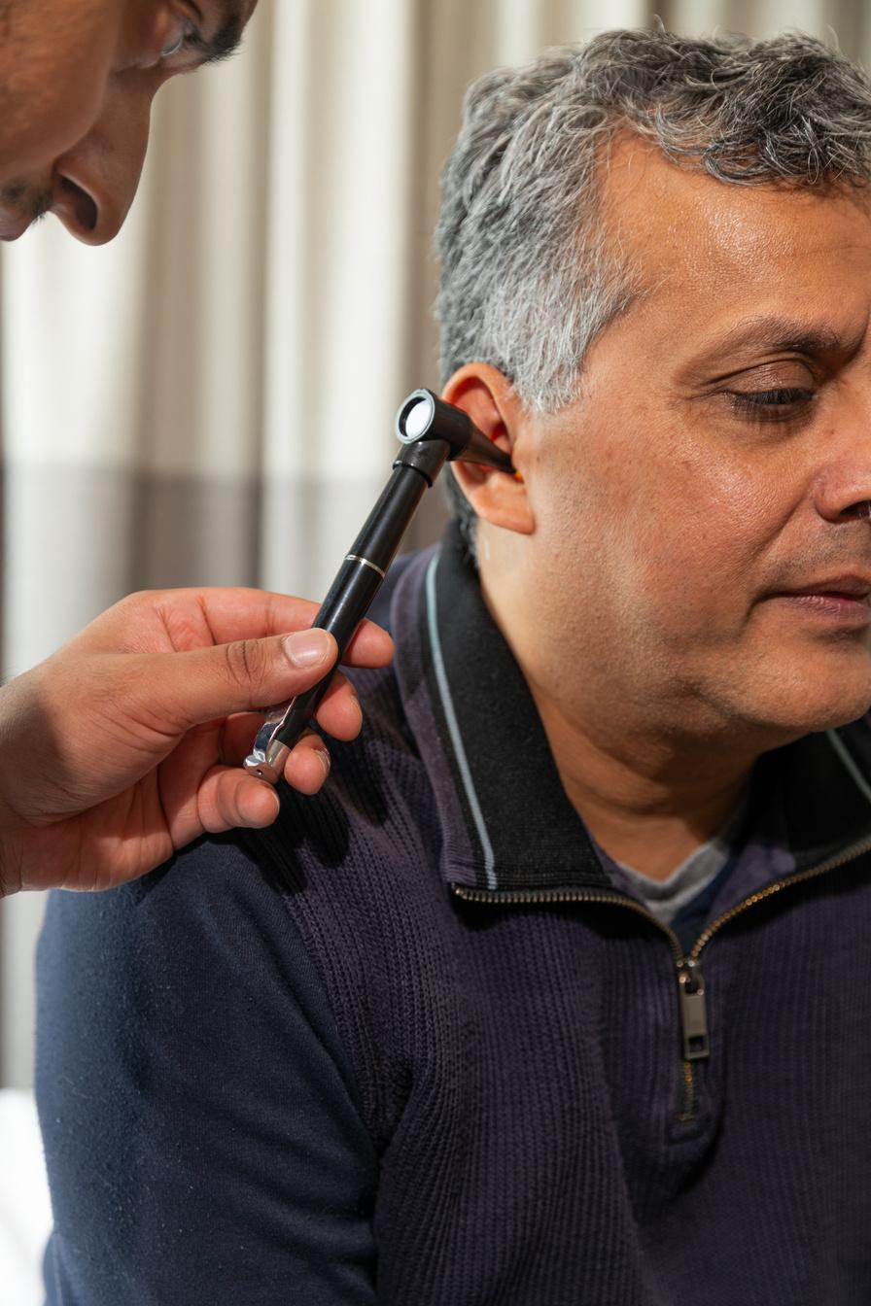


MODEL 3: CATBOOST (BEST MODEL)
Accuracy: 78.17%
AUC-ROC: 0.8614
Why it’s best :
✔ Handles categorical & numeric features
✔ Captures complex interactions
✔ Highest predictive power
Confusion Matrix :
Correct Good Health: 6636
Correct Poor Health: 6471
Most balanced among the three models
78.17%
Accuracy

Slide 11
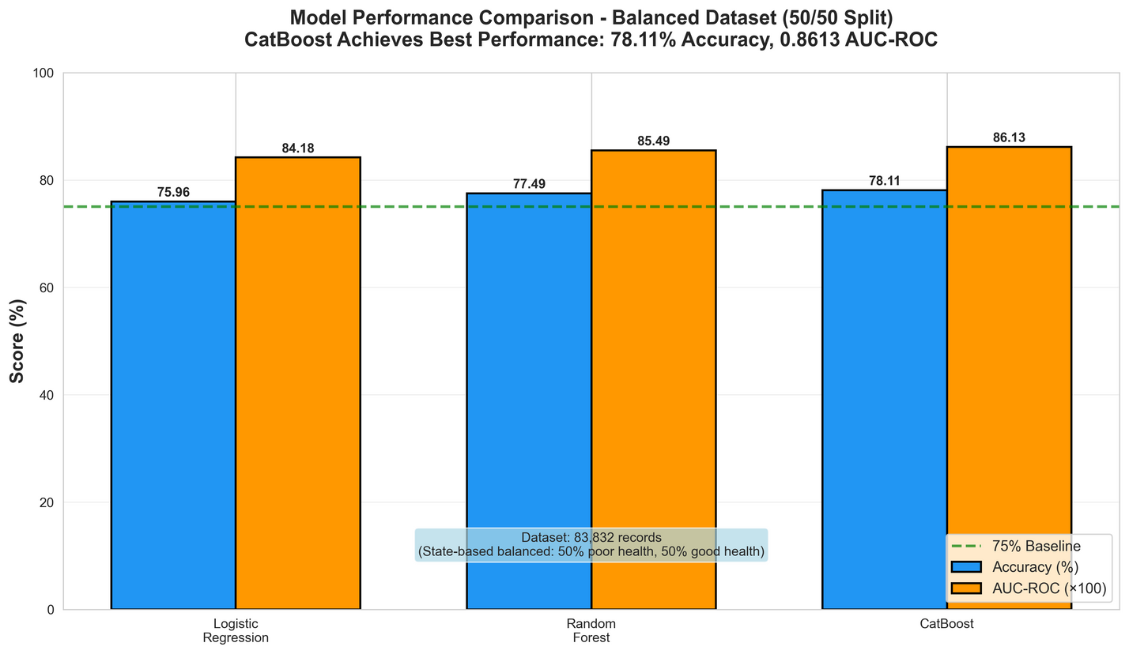
Model Performance: CatBoost Performs Best
CatBoost: 78.11% accuracy, 0.861 AUC-ROC
Random Forest: 77.49% accuracy
Logistic regression performs lower
Balanced dataset (50/50) improved fairness and reduced bias

Slide 12
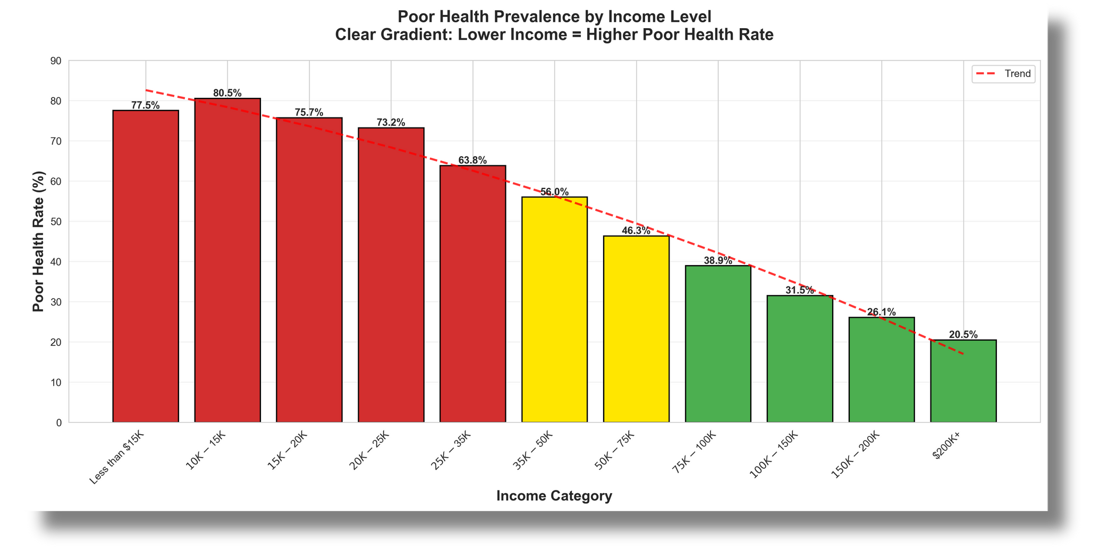
KEY INSIGHTS :
1. Income is a major health predictor
Lower income → significantly higher poor-health probability
Income is among top features across all models.
2. Financial stress worsens health
Lack of insurance
Unable to afford doctor visits
Unemployment
All show strong contribution to poor health.
3. Health limitations
BMI, exercise
Diabetes
Difficulty performing daily tasks
Mental health days

Slide 13
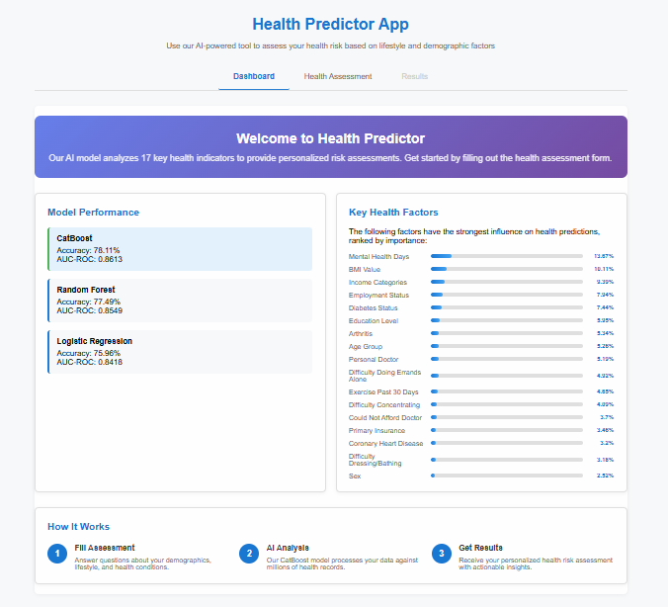
Health Predictor App - Final Model Deployment
What Our App Does :
Predicts health risk using 17 key factors
Uses our best model (CatBoost: 78% accuracy)
Income variables contributing around 36%.
Key Features :
Model Performance Dashboard
Top Health Predictors Chart
Interactive Health Assessment Form
Instant Good/Poor Health Output
Why It Matters :
Turns our ML model into a real, usable tool
Makes preventive health insights accessible to everyone

Slide 14
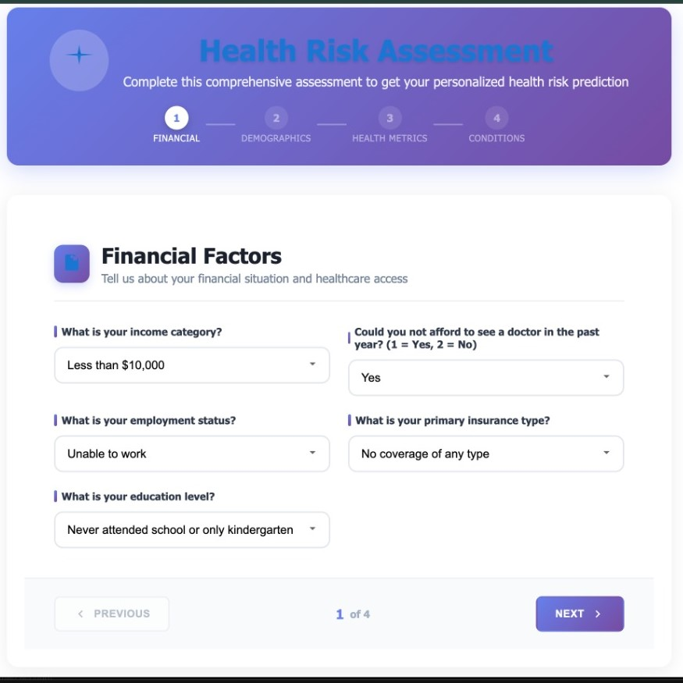
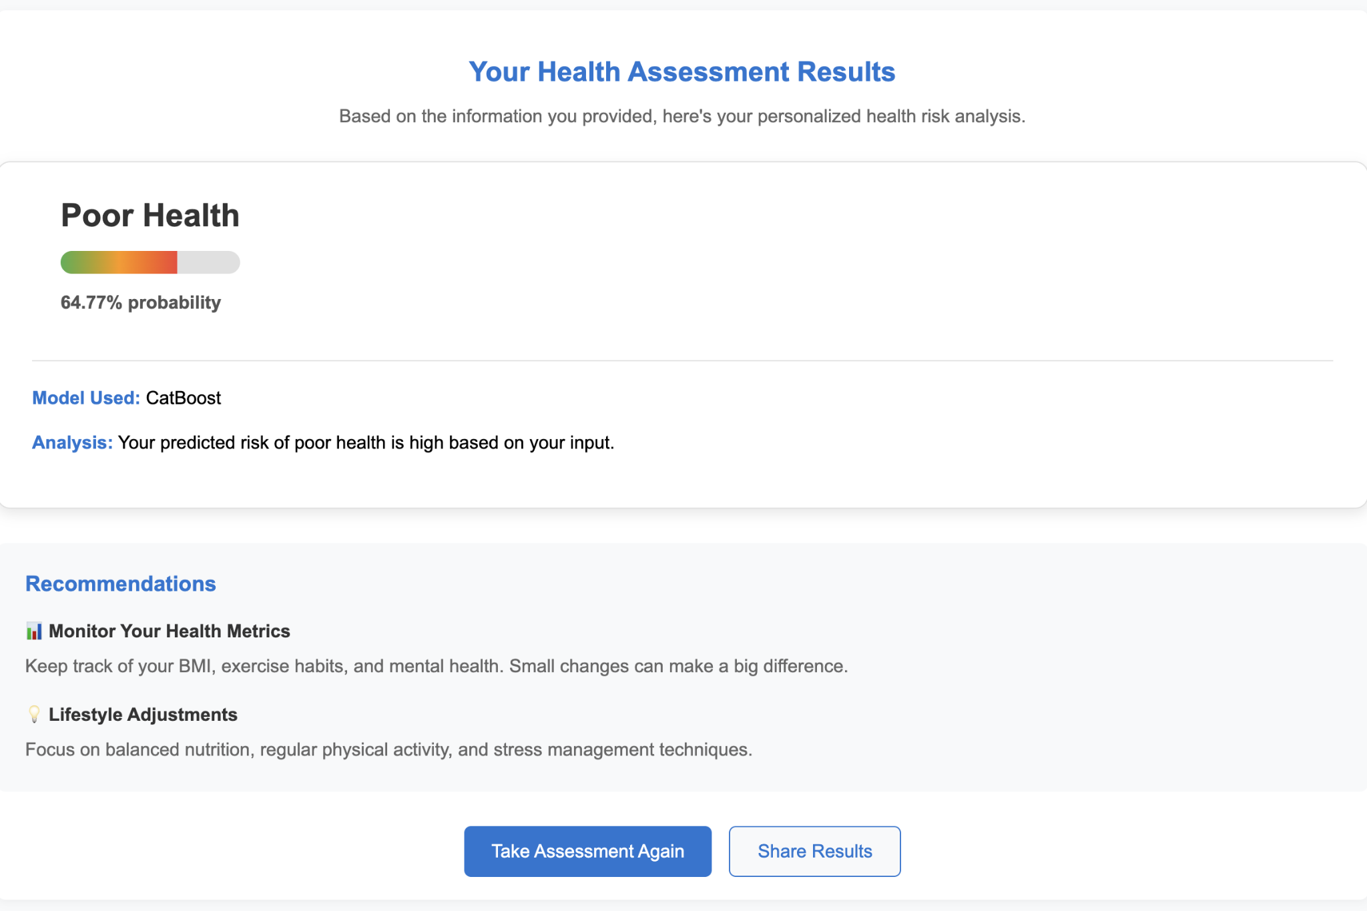

Slide 15
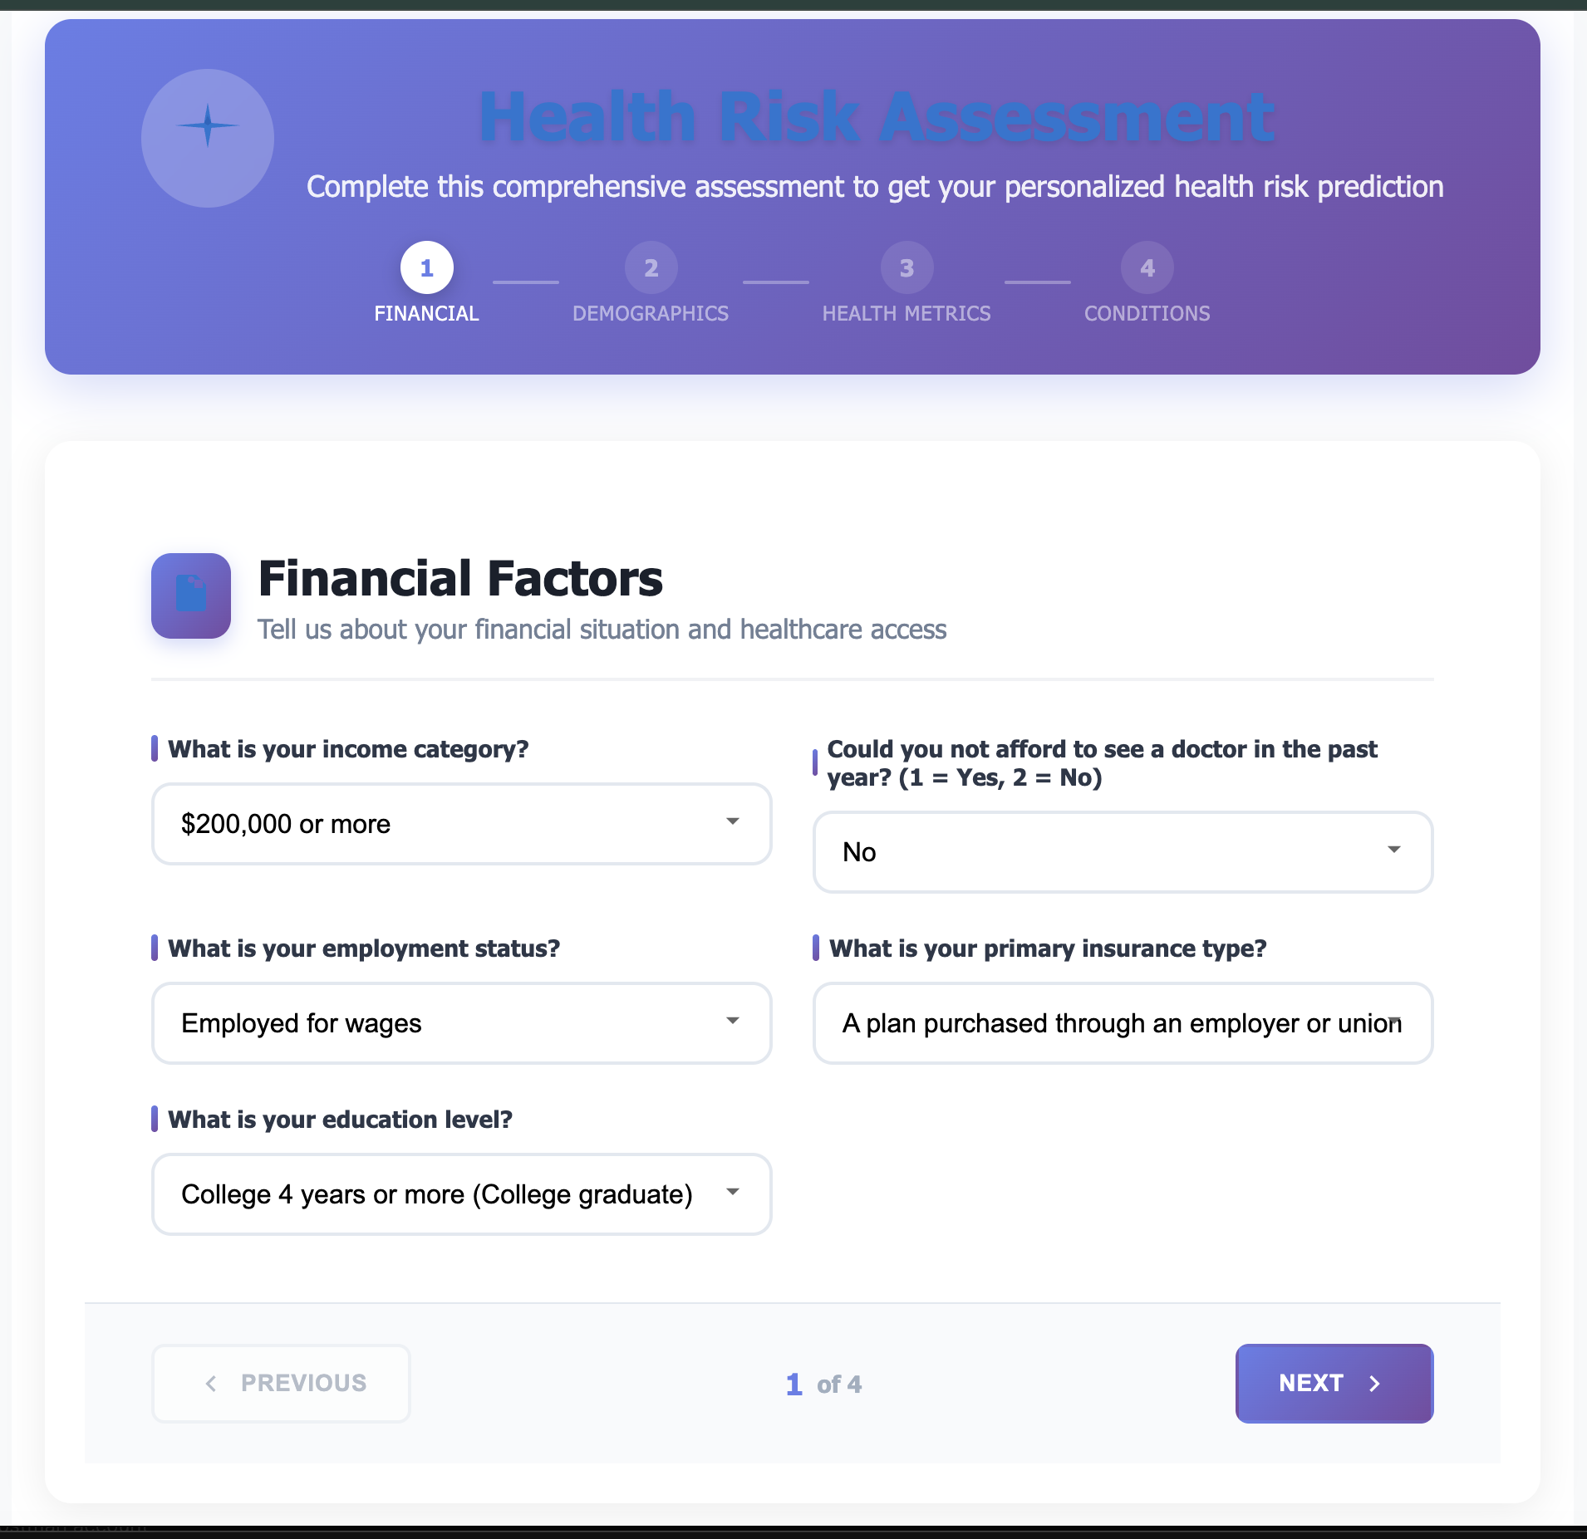
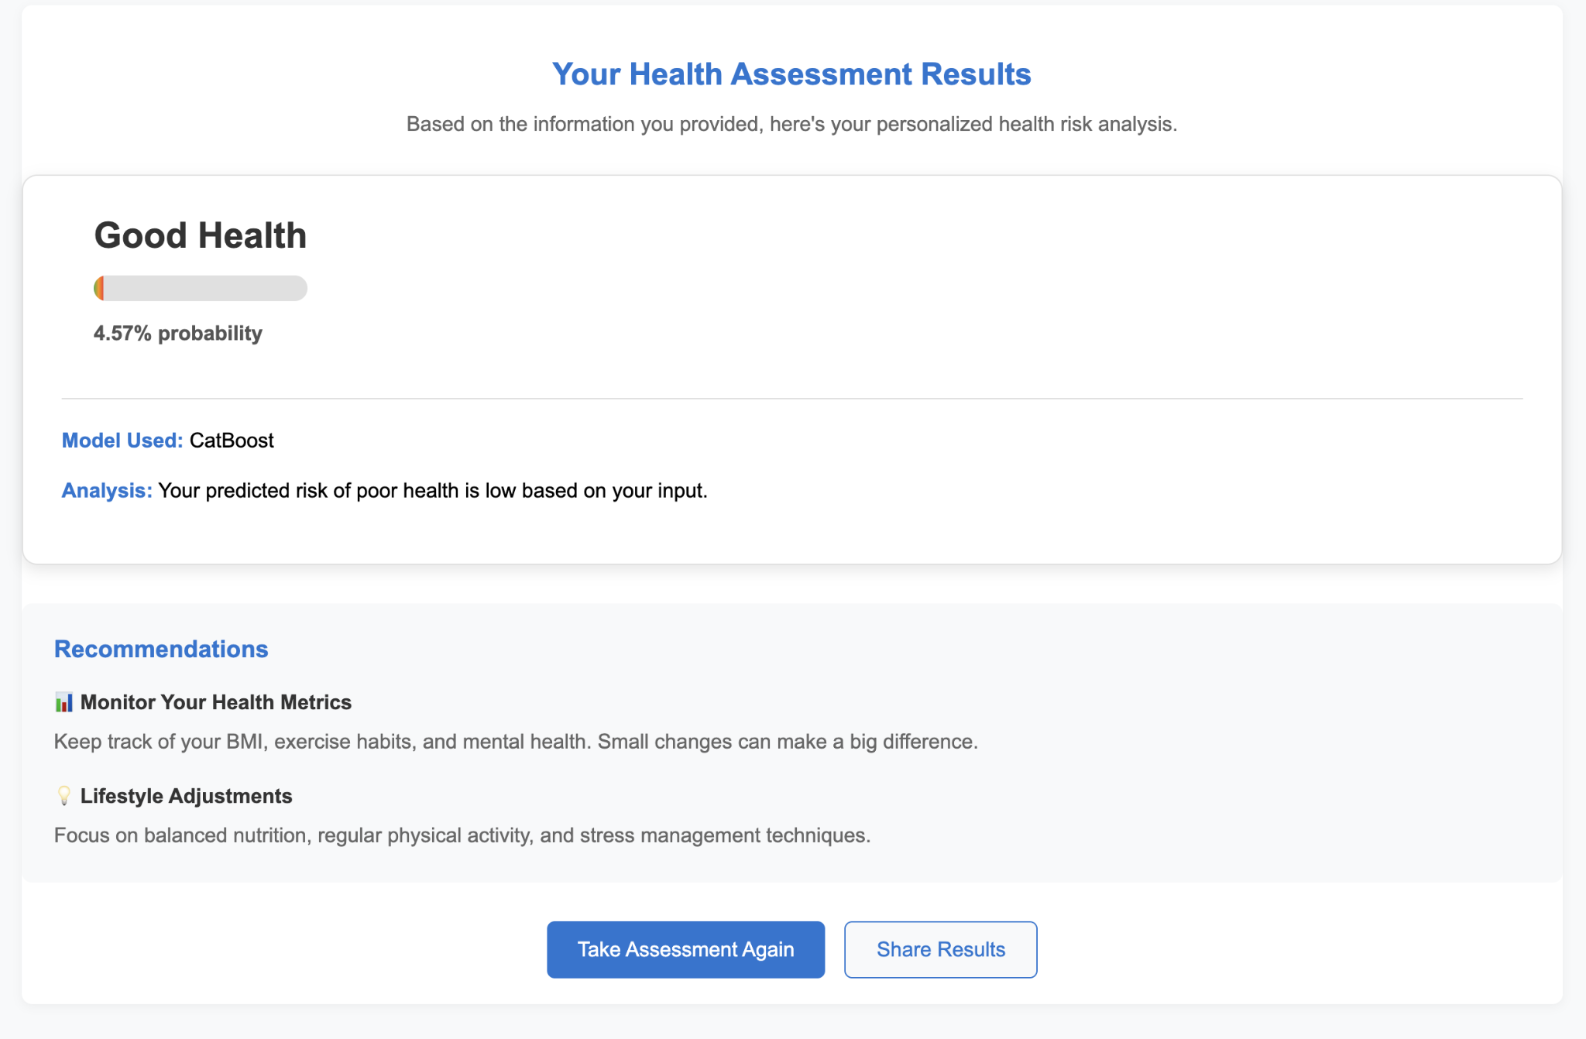

Slide 16
FINAL CONCLUSION
Income & financial barriers directly impact health outcomes.
The best model (CatBoost) achieves 78% accuracy and 86% AUC.
Financial variables consistently appear among the top features.
Improving affordability and access to healthcare could improve overall population health.

Slide 17
Thank
You

